Slide 1

TIME SERIES FORECASTING USING LLM’S

Slide 2
Team
Vinayak S.G
Mentor
Kasi Ravi Babu
Data Science Intern
Sathyalakshmi Narasimhan
Data Science Intern

Slide 3







Agenda
objective
Process
EDA Findings
Models Overview
Future Scope
Business Usecases
Key Findings
Limitations
Metrics Comparision
Results

Slide 4

Timeseries Forecasting using LLm's / Gen AI
Time series forecasting is a crucial task in finance, allowing investors and analysts to make informed decisions about stock prices. This project explores the application of Large Language Models (LLM) and General Artificial Intelligence (Gen AI) methods, to forecast Tesla's stock price. We evaluate the performance of various models on the Tesla stock price data set.
Problem Statement & Description :Traditional models struggle with financial data LLMs are emerging to revolutionize time series forecasting, capturing complex patterns, handling noisy data, and adapting to changing markets, leading to:
Enhanced decision-making
Improved risk management
New predictive analytics opportunities
Transformation of financial forecasting
Objective:
Explore and Compare Models:
Develop Accurate Forecasting Models:
Evaluate and Select the Best Model:

Slide 5
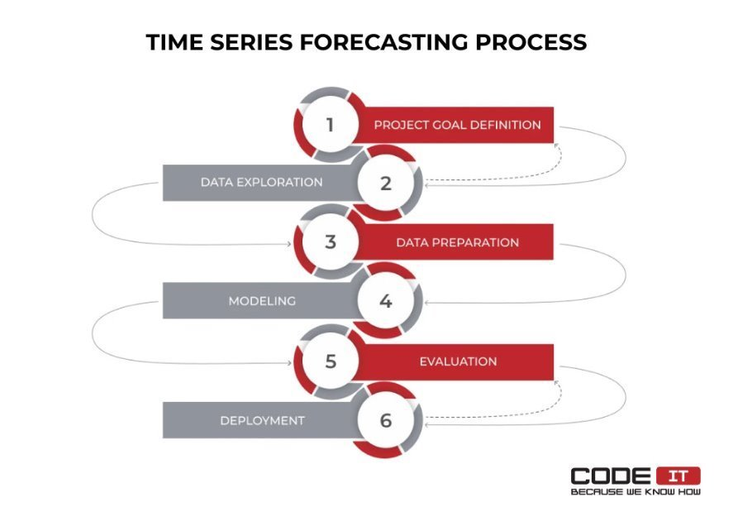
Process of the time series forecasting
Data Description :The dataset includes 3,509 rows of historical daily Tesla stock prices from June 29, 2010, to June 6, 2024. It features the following columns: Date, Open, High, Low, Close, Volume, and Adjusted Close.
Exploratory Data Analysis :
Exploratory Data Analysis (EDA)
Data Preprocessing
Sorted data by date
Selected 'Close' price for analysis
Handling Non-Continuous Time Stamps
No missing values
Addressed non-trading days using business days as index and Forward Fill (Ffill) method
Feature Selection
Time (Index): captures temporal dependencies and patterns
Closing Price: most critical feature for forecasting stock prices
Scaling of Closing Price
Normalized closing price data using standard scalar

Slide 6
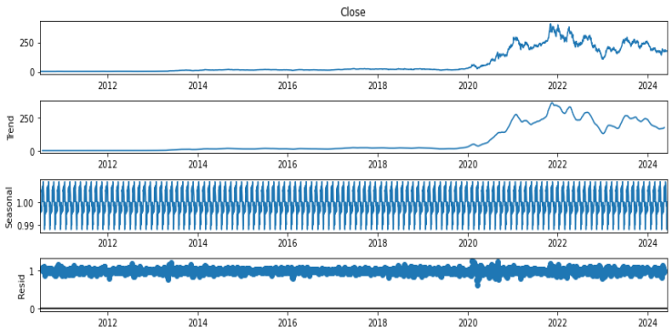
Findings from EDA
Upward trend in Tesla's closing price
Volatility changes over time
Price movement and volatility are connected
Smoother trends with larger window size
Peak trading volume in 2020-2021
Highest trading volume on 2020-02-04
Time series not stationary at level (p-value = 0.6243)
Time series stationary after first differencing (p-value ≈ 0)

Slide 7
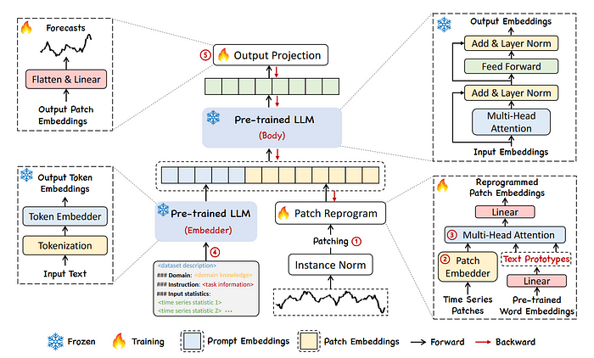
Models Overview
Models Used for Timeseries forecasting
Traditional methods
1.ARIMA
2.Linear Regression
3.Random Forest Regression
4.Xgboost
5.LSTM
Nueral Networks
Nbeats
LLM Models
TimesFM :Time Series Foundation Model by Google
Chronos : pretrained llm model by Amazon
TimeGPT : first time series foundation model capable of zero-shot inference by Nixtla
GPT2 :"Generative Pre-trained Transformer 2," is a state-of-the-art language model developed by OpenAI.

Slide 8
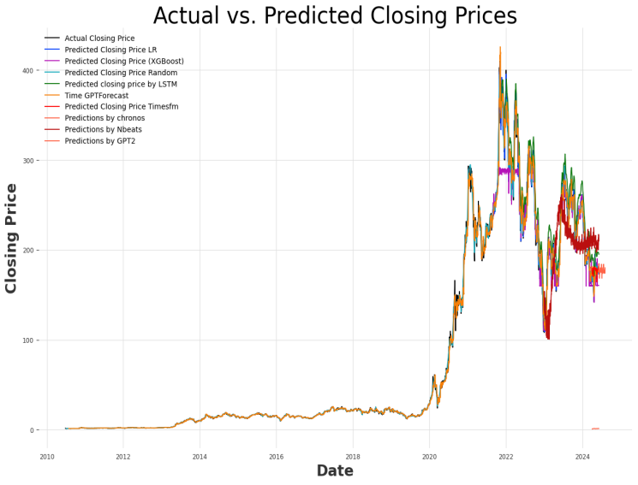
Results

Slide 9
Evaluation Metrics Comparision
Model | Approach | MSE | RMSE | MAE | MAPE
ARIMA | GRID Approach | 22.2039 | 4.7121 | 2.01581 | 0.0249
ARIMA GAN | GAN method | 3773.74145 | 61.43078 | 49.32236 | 0.21969
Linear Regression | Default | 11.77 | 3.43 | 2.53 | 0.0104
Xg boost | Default | 638.92 | 25.28 | 13.57 | 0.0486
Random Forest Regressor | Default | 6.23 | 2.50 | 1.00 | 0.0117
LSTM | Default | 207.33 | 14.40 | 10.74 | 0.00045
TimeFM | Default | 0.0107 | 0.00535 | 0.0726 | 0.0726
Chronos | Default | 0.39699 | 0.630077 | 0.535692 | 0.54601
TimeGPT | Forward Fill | 34.448 | 5.869 | 2.449 | 3.049
TimeGPT | Business Days with Forward Fill | 26.434174 | 5.141418 | 3.691989 | 2.056152
N-BEATS | Default | 0.0020 | 39.34 | 33.80 | 0.1701
GPT-2 | Default | 119.92 | 10.95 | 7.88 | 0.048
GPT-2 | Data Augmentation | 1.0789 | 1.0387 | 0.8814 | 2.2438

Slide 10
Key Findings
Best Performing Models:
TimeFM: Best overall metrics (MSE, RMSE, MAE, MAPE).
N-BEATS: Excellent MSE and RMSE, though MAE and MAPE are higher.
GPT-2 with Data Augmentation: Shows significant improvement but is outperformed by TimeFM and N-BEATS in some metrics.
Challenges:
Handling different types of data.
Computational complexity for LLMs.
Summary: TimeFM and N-BEATS show the best performance in terms of MSE and RMSE. Models like GPT-2 with Data Augmentation improve performance but require more tuning.
Next Steps:
Explore hybrid models combining the strengths of different approaches.
Investigate interpretability and scalability for large datasets.
Enhance data preprocessing and feature engineering techniques.

Slide 11

Limitations
High computational complexity requiring significant resources for training and inference.
Large data requirements for effective model training.
Data Quantity Limited data points, 3500
Data Quality Inadequate capture of volatility
Risk of overfitting due to the model's capacity to capture complex patterns.
Limited interpretability, making it challenging to understand how predictions are made.
Difficulty adapting to non-stationary data with changing patterns over time.
Dependency on historical data, which can result in lagged response to sudden shifts in the underlying process
Challenges in fine-tuning LLMs Due to time and memory constraint

Slide 12
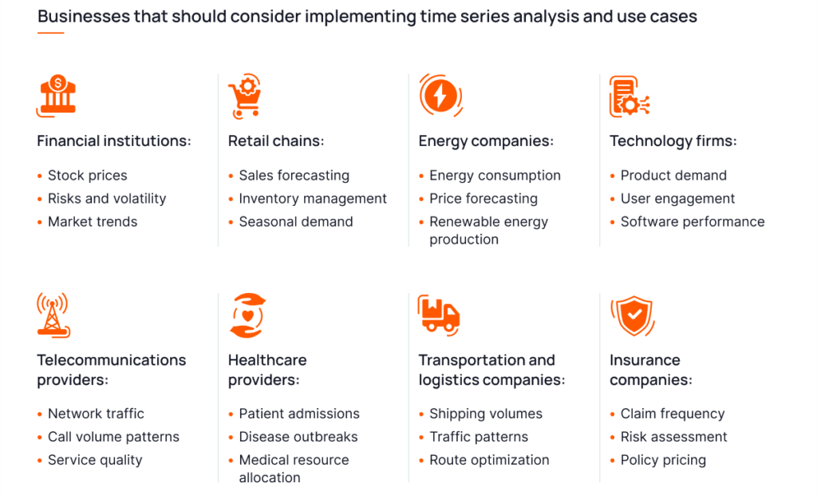
Business Applications

Slide 13

Future Scope
Hybrid Models:
Combining LLMs with Traditional Models
Continual Learning:
Adaptation to New Data
Enhanced Interpretability:
Explainable AI
Data Augmentation:
Synthetic Data .
Real-Time Forecasting:
Optimizing Inference Time
Domain-Specific Adaptations:
Custom Architectures
Transfer Learning:
Cross-Domain Applications

Slide 14
Conclusion
Explored traditional, ML, DL, and Generative AI models for stock price prediction and time series forecasting.
Identified top-performing models and areas for enhancement.
Predictive analytics has far-reaching implications across industries and applications.
Restricted dataset poses a challenge for broader generalizability.
High computational requirements may hinder adoption for smaller organizations.
Contributes to the growth and development of predictive analytics.
Empowers data-driven decision making and strategic investments.
Anticipates further breakthroughs in time series forecasting using LLMs.

Slide 15
THANK YOU

